Slide 1
CSCI 1101 Introduction to Computer Science
Introduction to Boolean Algebra and
Logic Circuits

Slide 2
Circuits and Boolean Algebra
Computers are constructed from logic circuits
Logic circuits perform operations on digital signals
Usually implemented as circuits where signal values are restricted to a few values (e.g., binary circuits)
But first, a short intro to Boolean algebra

Slide 3
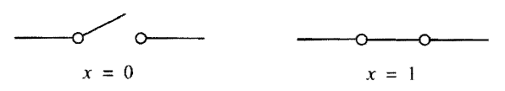
Binary Circuits
Circuit with 2 possible states, open (x = 0) or closed (x = 1), where x is the input variable that controls the switch

Slide 4
Boolean Algebra
Named for George Boole, who in 1849 introduced a scheme for describing in algebra the processes involved in logical reasoning
In 1930’s, Claude Shannon showed that Boolean algebra provided a means of describing circuits built with switches
Provides foundation for much of modern technology

Slide 5
Fundamental Operations
Boolean algebra works with variables that can have only 2 values – true or false (1 or 0, respectively)
The fundamental operations of Boolean algebra are AND, OR, and NOT

Slide 6
NOT Operation
NOT takes one variable/argument/input
NOT is true if the input variable is false
NOT (true) = false
NOT (false) = true
We’ll see another way to represent this in a minute

Slide 7
AND and OR Operations
An AND function of variables x₁, x₂, …, x_{n} has the value 1 only if all n variables are equal to 1.
AND is like multiplication
An OR function of variables x₁, x₂, …, x_{n} has the value 1 if at least one, or more, of the n variables are equal to 1
OR is like addition

Slide 8
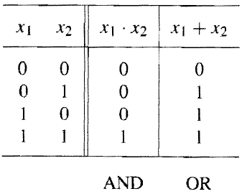
Truth Tables
Used to define logic operations
Truth table for AND and OR operations with 2 inputs, x₁ and x₂

Slide 9
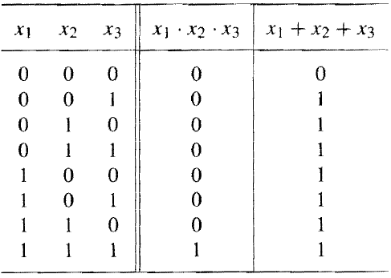
Extending AND and OR
AND and OR can be extended to n variables
Truth table for AND and OR operations with 3 inputs
What would the truth table for NOT look like?

Slide 10
Axioms of Boolean Algebra
Boolean algebra is based on set of rules that are derived from a small number of basic assumptions – axioms
Basic assumption: Boolean algebra, B, involves elements that take on one of two values, 0 and 1.
The following axioms are assumed to be true…

Slide 11
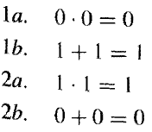
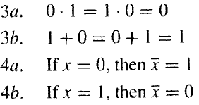
Axioms of Boolean Algebra

Slide 12
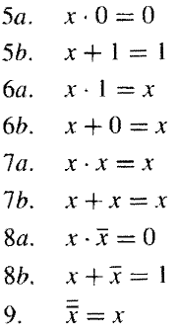
Single Variable Rules (Theorems)
From the axioms, we define rules (theorems) for dealing with single variables
We can prove by perfect induction (substitute x = 0 and x = 1 in each expression and use axioms)

Slide 13
Principle of Duality in Boolean Algebra
Given a logic expression, we get its dual by replacing all + with (and vice versa) and by replacing 0s with 1s and 1s with 0s.
The dual of any true statement, axiom or theorem, in Boolean algebra is also a true statement
This means that at least 2 different ways exist to express every logic function

Slide 14
Two- and Three- Variable Properties
We often need to deal with a number of variables
Define some 2- and 3-variable identities
Give the dual of each identity
Often referred to as properties
If x, y, and z are variables in B, the following properties hold…

Slide 15
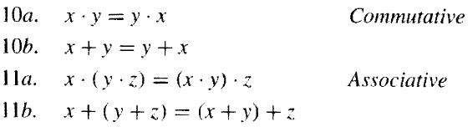
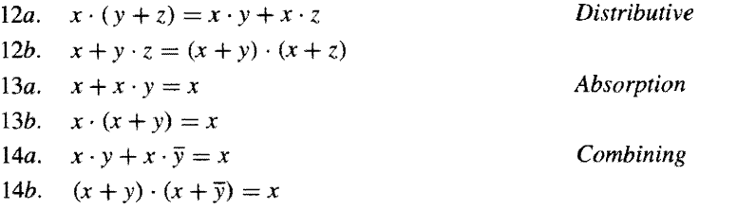
Properties

Slide 16
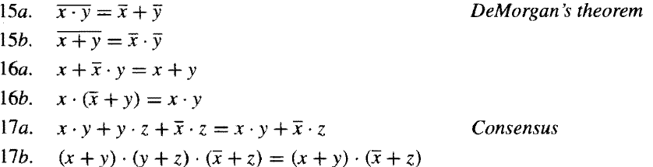
Properties

Slide 17
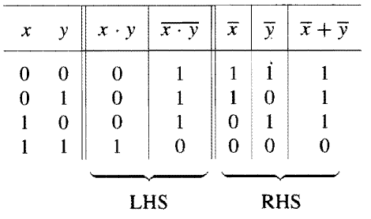
Properties
We can prove by perfect induction (truth tables), algebraic manipulation, or Venn diagrams
Example: proving DeMorgan’s theorem using truth table

Slide 18
Venn Diagrams
Using truth tables to verify theorems and properties can be tedious, and may not be conceptually informative
Venn diagrams are a tool that provides for more intuitive understanding of how expressions may be equivalent
Graphical illustration of set algebra
We’re not going to talk about them.

Slide 19
Equivalent Notations
The following notations are equivalent:
_
X’ same as X
_____
(X + Y)’ same as X + Y

Slide 20
Other Notation
Using the same symbols for arithmetic and logic can be confusing
We can use the following notation:
AND ∧, e.g., x₁ ∧ x₂
OR ∨, e.g. x₁ ∨ x₂

Slide 21
Precedence of Operations
In the absence of parentheses, a logic expression is evaluated in the following order:
NOT
AND
OR

Slide 22
Computers and Electricity
Gate
A device that performs a basic operation on electrical signals
Circuits
Gates combined to perform more complicated tasks

Slide 23
Gates
Six types of gates
NOT
AND
OR
XOR
NAND
NOR

Slide 24
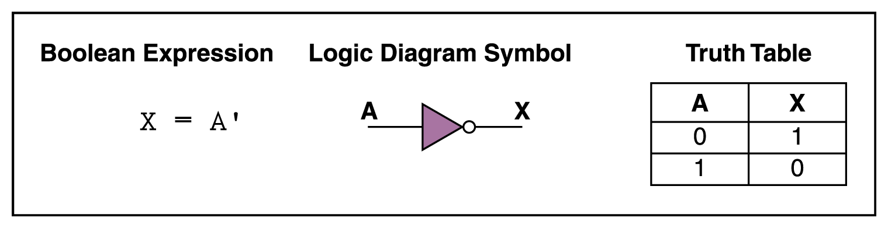
NOT Gate
A NOT gate accepts one input signal (0 or 1) and returns the opposite signal as output

Slide 25
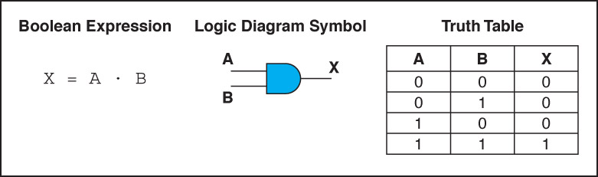
AND Gate
An AND gate accepts two input signals
If both are 1, the output is 1; otherwise, the output is 0

Slide 26
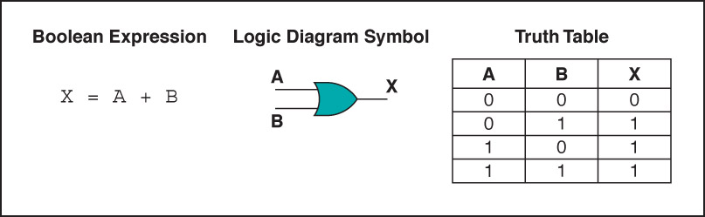
OR Gate
An OR gate accepts two input signals
If both are 0, the output is 0; otherwise, the output is 1

Slide 27
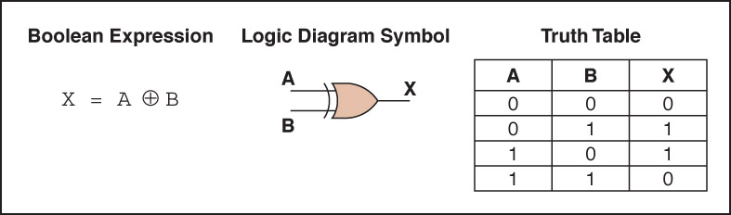
XOR Gate
An XOR gate accepts two input signals
If both are the same, the output is 0; otherwise,
the output is 1

Slide 28
XOR Gate
Note the difference between the XOR gate and the OR gate; they differ only in one input situation
When both input signals are 1, the OR gate produces a 1 and the XOR produces a 0
XOR is called the exclusive OR
OR is the inclusive OR

Slide 29
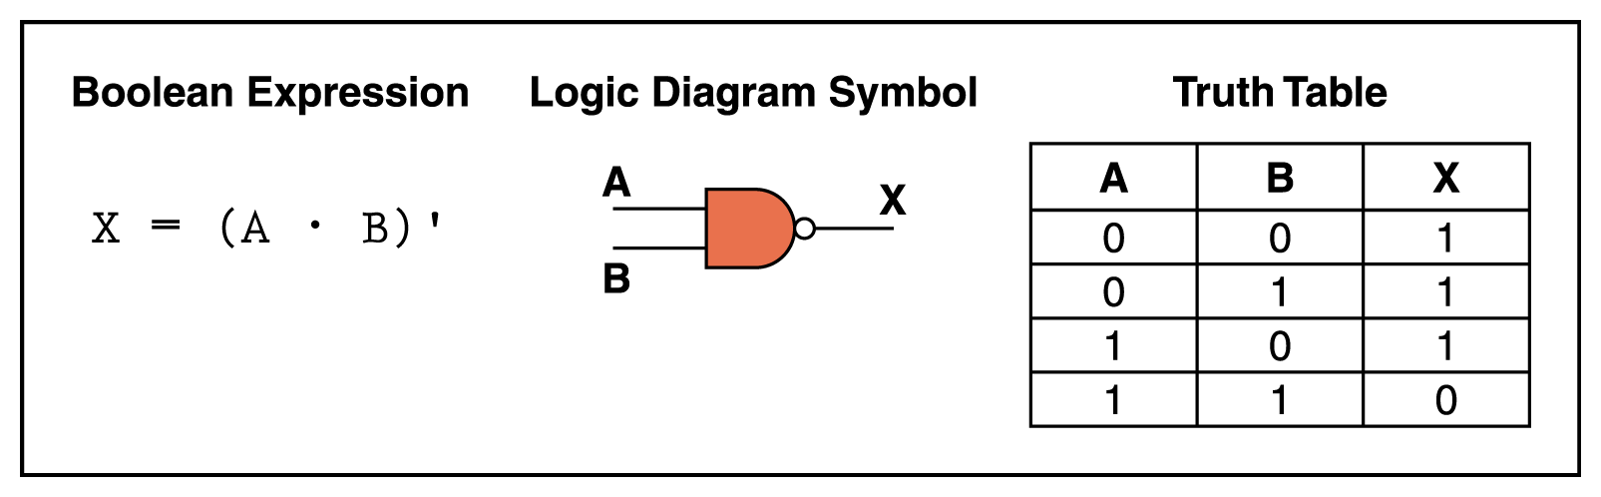
NAND Gate
The NAND gate accepts two input signals
If both are 1, the output is 0; otherwise, the output is 1

Slide 30
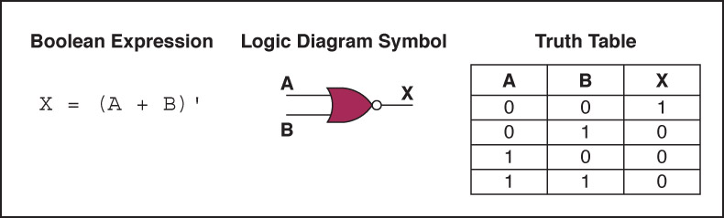
NOR Gate
The NOR gate accepts two input signals
If both are 0, the output is 1; otherwise, the output is 0

Slide 31
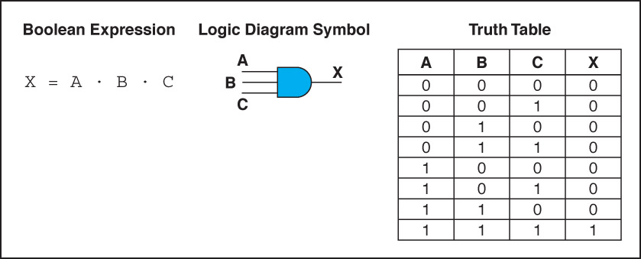
Gates with More Inputs
Gates can be designed to accept three or more input values
A three-input AND gate, for example, produces an output of 1 only if all input values are 1

Slide 32
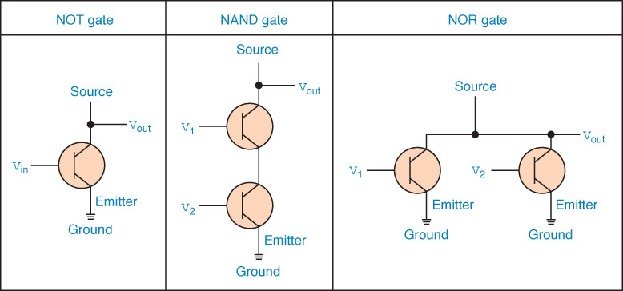
Constructing Gates
Gates are constructed with transistors
(Transistor count: http://en.wikipedia.org/wiki/Transistor_count)
A device that acts either as a wire that conducts electricity or as a resistor that blocks the flow of electricity, depending on the voltage level of an input signal
The easiest gates to create are the NOT, NAND, and NOR gates
You will learn more about this in your digital systems course

Slide 33
Circuits
Combinational circuit
The input values explicitly determine the output
Sequential circuit
The output is a function of the input values and the existing state of the circuit
We describe the circuit operations using
Boolean expressions
Logic diagrams
Truth tables

Slide 34
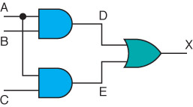
Combinational Circuits
Gates are combined into circuits by using the output of one gate as the input for another

Slide 35
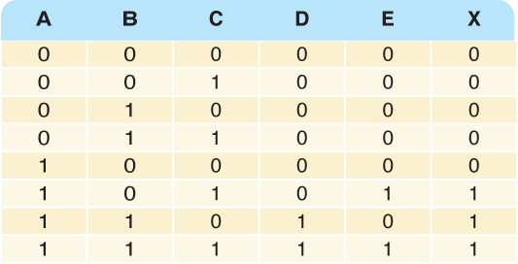
Combinational Circuits
Three inputs require eight rows to describe all possible input combinations
This circuit is described by the Boolean expression (AB + AC)

Slide 36
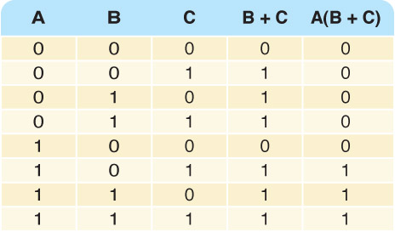

Combinational Circuits
Consider the following Boolean expression A(B + C)
Does this truth table look familiar?
Compare it with previous table…

Slide 37
Combinational Circuits
Circuit equivalence
Two circuits that produce the same output for identical input
Boolean algebra allows us to apply provable mathematical principles to help design circuits
A(B + C) = AB + AC (distributive law) so circuits must be equivalent
AB+AC
A(B+C)

Slide 38
Adders
At the digital logic level, addition is performed in binary
Addition operations are carried out by special circuits called, appropriately, adders

Slide 39
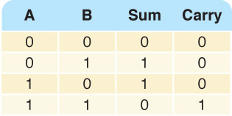
Adders
The result of adding two binary digits could produce a carry value
Recall that 1 + 1 = 10 in base two
Half adder
A circuit that computes the sum of two bits and produces the correct carry bit
Truth table

Slide 40
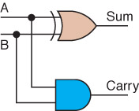
Adders
Circuit diagram representing a half adder
Boolean expressions
sum = A ⊕ B
carry = AB

Slide 41
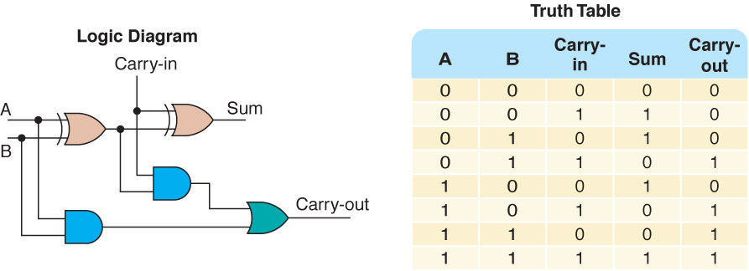
Adders
Full adder
A circuit that takes the carry-in value into account

Slide 42
Circuits as Memory
Digital circuits can be used to store information
These circuits form a sequential circuit, because the output of the circuit is also used as input to the circuit

Slide 43
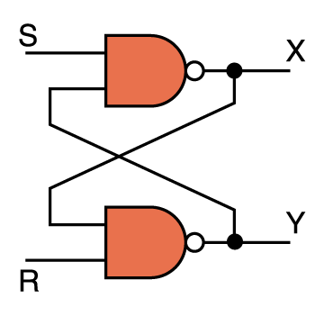
Circuits as Memory
An S-R latch stores a single binary digit (1 or 0)
The output of one gate is used as an input to the other gate

Slide 44
Circuits as Memory
The design of this circuit guarantees that the two outputs X and Y are always complements of each other
The value of X is considered to be the current state of the circuit
If X is 1, the circuit is storing a 1
If X is 0, the circuit is storing a 0

Slide 45
Circuits as Memory
S-R latch truth table
S | R | X | Y
0 | 0 | Not allowed (forbidden state)
0 | 1 | 1 | 0
1 | 0 | 0 | 1
1 | 1 | No change in the output

Slide 46
Integrated Circuits
Integrated circuit (also called a chip)
A piece of silicon on which multiple gates have been embedded
Silicon pieces are mounted on a plastic or ceramic package with pins along the edges
Pins can be soldered onto circuit boards or inserted into appropriate sockets

Slide 47
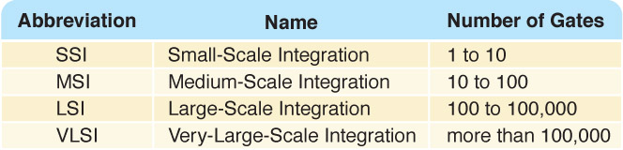
Integrated Circuits
Integrated circuits (IC) are classified by the number of gates contained in them

Slide 48
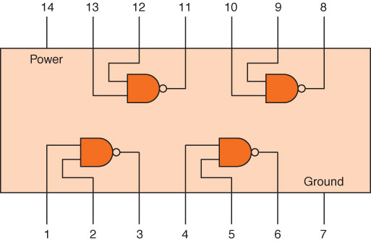
Integrated Circuits
Example SSI chip containing independent NAND gates

Slide 49
CPU Chips
The most important integrated circuit in any computer is the Central Processing Unit, or CPU
Each CPU chip has a large number of pins through which essentially all communication in a computer system occurs
We will look at the CPU in more detail soon

